Slide 1
Passive Reconnaissance
Project Report
Prepared by: Bernard Mbata
Date: October 21, 2025
1

Slide 2
Executive Summary
This passive reconnaissance project identified publicly accessible data for MegaCorp One
using only OSINT techniques.
Key findings include publicly accessible directories, archived pages with contact emails,
and exposed subdomains.
Objective: Demonstrate how passive intelligence gathering identifies potential attack surfaces.
2

Slide 3
Methodology
Tools & Sources:
• Amass (passive)
• Whois lookups
• Wayback Machine
• Directory browsing/Google dork
• Manual OSINT verification
Rules: No active scanning or probing performed. Only publicly available data collected.
3

Slide 4
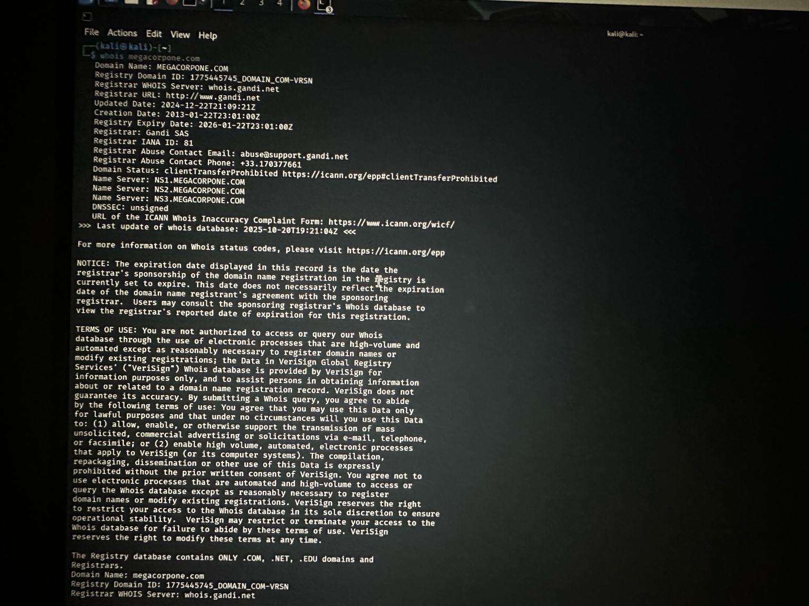
Finding A — Whois Domain Enumeration
The Whois command was used to identify MegaCorp One’s domain registrar, name servers,
and DNSSEC configuration.
The query revealed:
• Registrar: Gandi SAS
• Name Servers: ns1, ns2, ns3.megacorpone.com
• Domain Creation Date: 2013-01-22
• Expiry Date: 2024-01-22
This confirms the organization’s DNS infrastructure and hosting provider, information
that could be leveraged for social engineering or DNS-based reconnaissance.
4

Slide 5
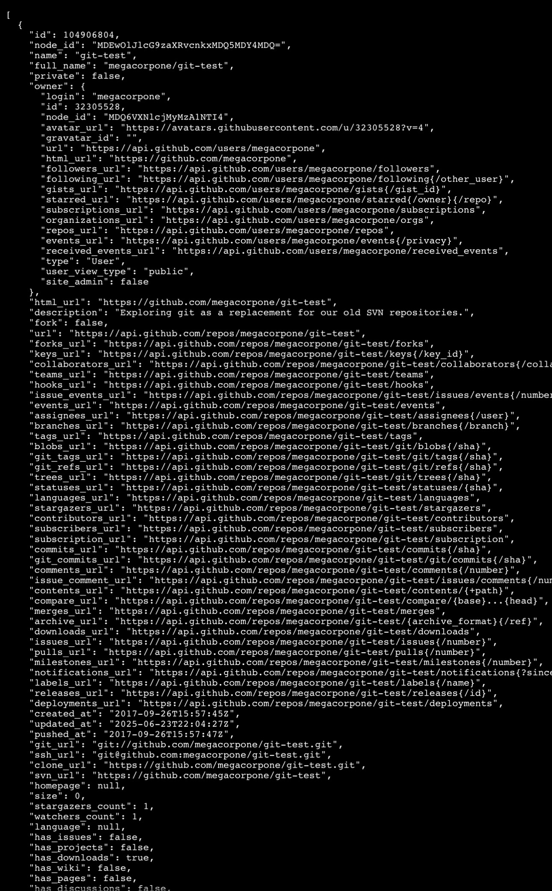
JSON metadata returned by GitHub’s API for
public repo.
Repo identity & URLs — name, full_name, html_url, clone_url, git_url, ssh_url.
→ lets you locate and fetch the repo (read-only for public repos) and see its web view/readme.
Owner info — owner.login, owner.html_url, avatar, id.
→ helps map people/orgs, find other repos, LinkedIn/GitHub profiles.
Timestamps — created_at, updated_at, pushed_at.
→ indicates activity level and recent changes (active projects may expose recent credentials or infrastructure changes).
Counts & popularity — stargazers_count, watchers_count, forks_count, size.
→ shows how widely used and forked the code is (more forks = more places to check).
Endpoints for related resources — issues_url, pulls_url, commits_url, releases_url, contents_url.
→ these let you passively enumerate issues/PRs/commits/releases which often contain useful context or links.
Language / homepage / topics — language, homepage.
5

Slide 6
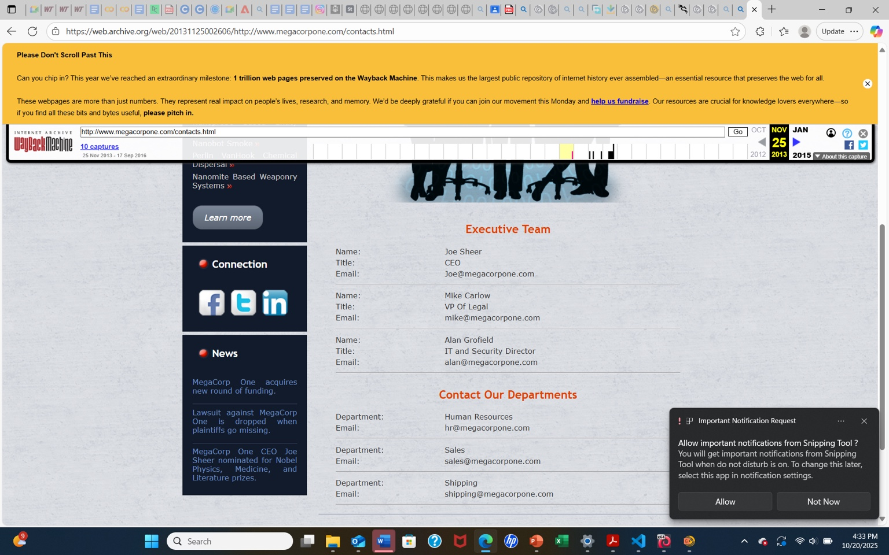
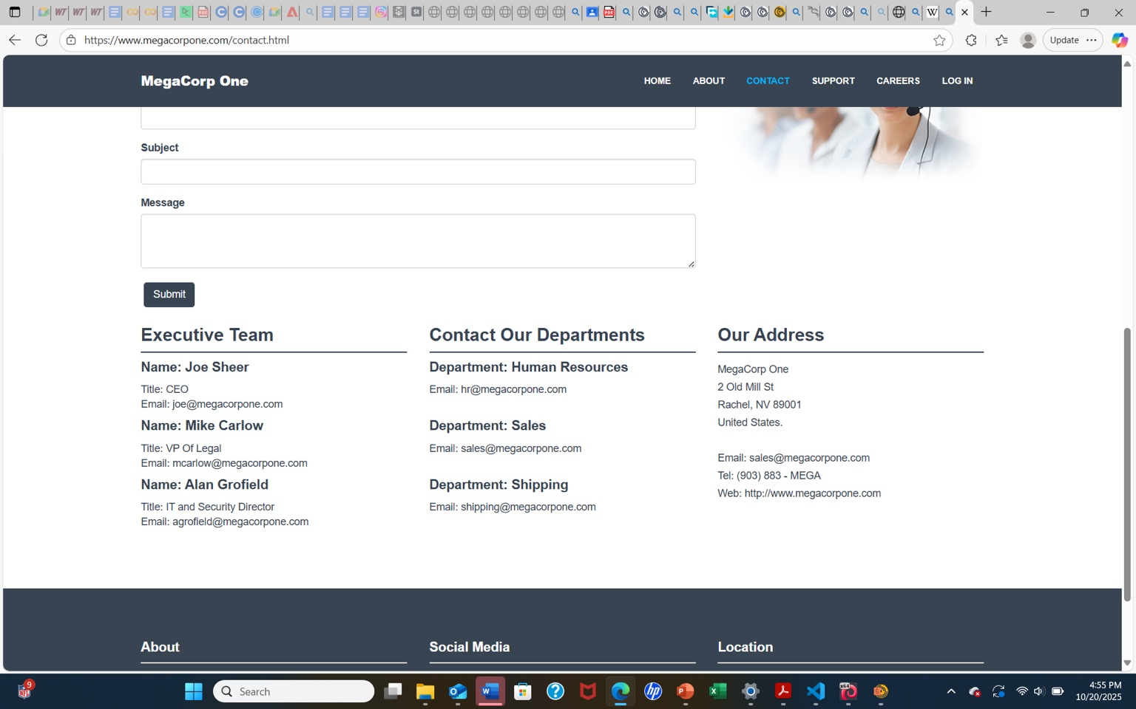
Wayback Machine Archived Contact List
The current site mirrors archived contact info, meaning exposure persists.
Archived pages contained names, roles, and emails of executives
(joe@megacorpone.com, mcarlow@megacorpone.com, alan@megacorpone.com).
Risk: High — still accessible publicly and enables phishing and impersonation attacks
Recommendation: Replace direct emails with contact forms.
6

Slide 7
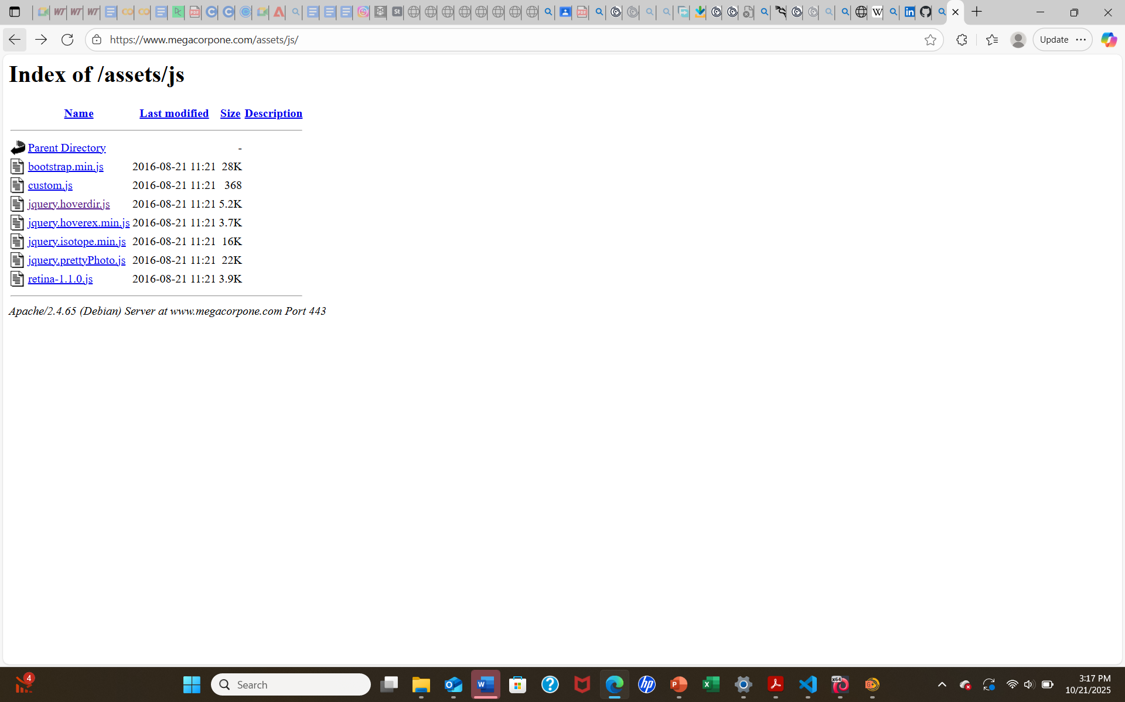
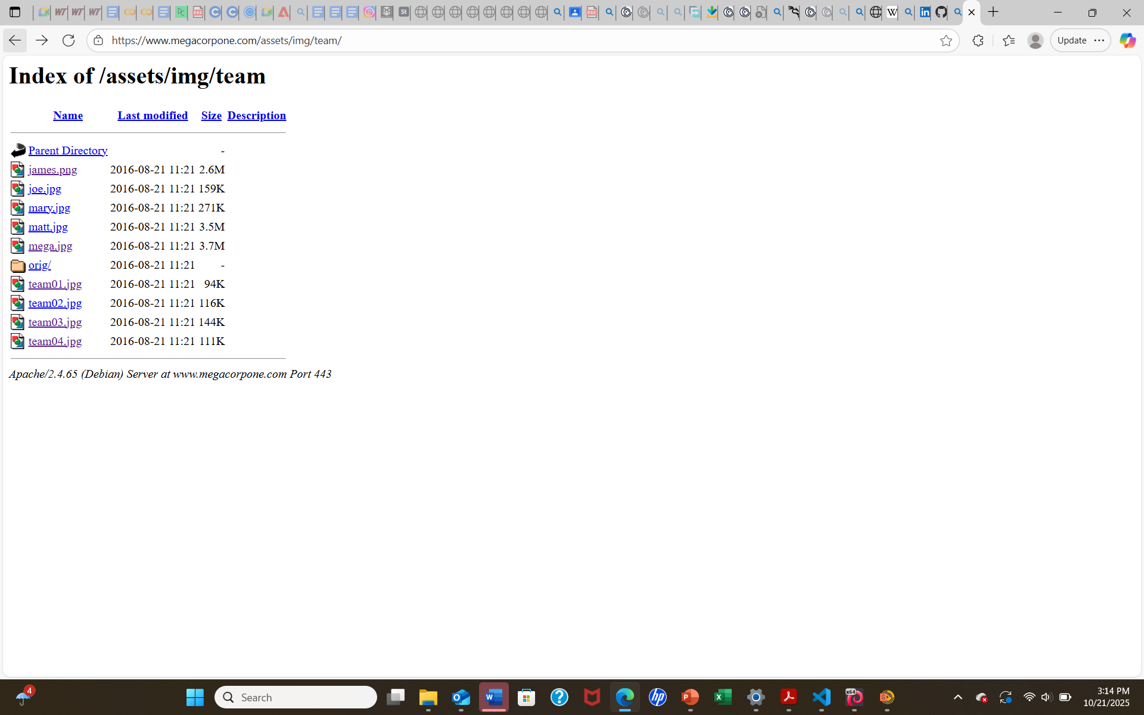
Finding D — Directory Index Exposure
cmd: megacorpone.com filetype
Accessible folders /assets/img/team/ and /assets/js/ listed internal images and scripts.
Risk: Medium — reveals file structures and staff details.
Recommendation: Disable directory listing and review access permissions.
7

Slide 8
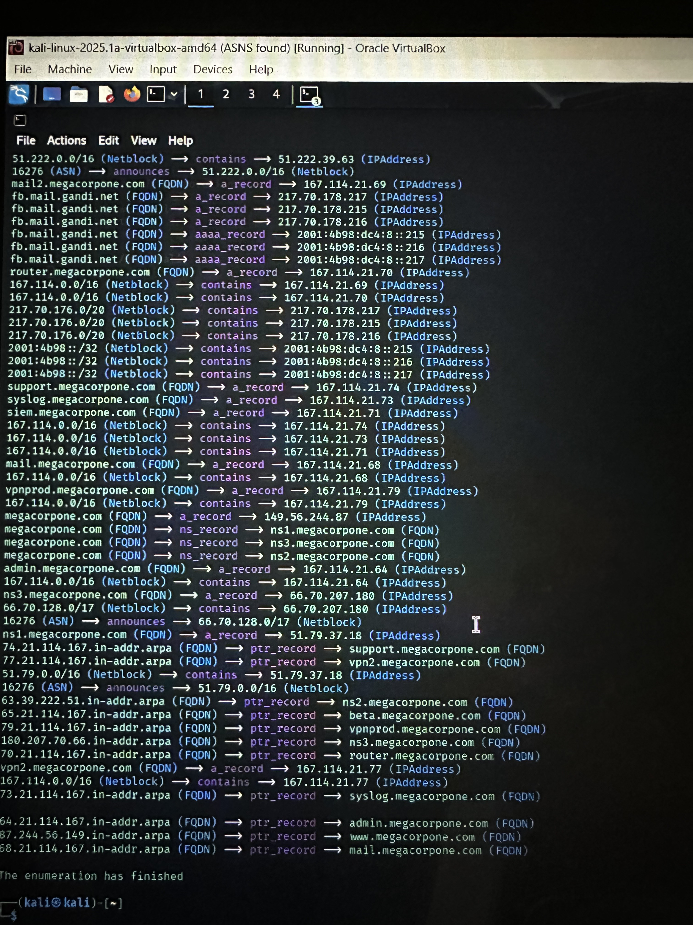
DNS Enumeration and Domain Infrastruture
Mapping
cmd: amass enum -passive -d megacorpone -o amass-passive.txt
During passive reconnaissance, several DNS records and subdomains were identified for
the target organization megacorpone.com.
Enumeration revealed critical infrastruture components including mail servers, administra-
tive portals, and VPN ebdpoints. The findings show multiple IPs within the 167.114.x.x ran-
ge, belonging to the same ASN, suggesting centralized hosting under a single provider.
Risk level: High- These records can be used to map the attack surface, identify potential
misconfiguration, and target systems in later active reconnais
9

Slide 9
Recommendations (Immediate)
• Disable directory indexing (Apache: Options -Indexes / Nginx: autoindex off)
• Lock cloud buckets and restrict public access
• Revoke exposed credentials
• Remove sensitive files and request Wayback removal
8

Slide 10
Recommendations (Short Term & Ongoing)
• Harden staging/dev environments or restrict via VPN
• Implement GitHub secret scanning
• Enforce least-privilege IAM policies
• Continuous OSINT monitoring
• SOC integration and training
• Conduct active testing post-remediation

Slide 11
Technical Remediation Commands
Disable directory listing on web servers:
• Apache:
sudo sed -i 's/Options Indexes/Options -Indexes/' /etc/apache2/sites-available/*.conf
sudo systemctl reload apache2
• Nginx:
autoindex off; then sudo nginx -s reload
Check for public buckets & lock them:
• AWS CLI:
aws s3api get-bucket-acl --bucket BUCKETNAME
aws s3api put-bucket-acl --bucket BUCKETNAME --acl private
Revoke any exposed keys:
• AWS:
aws iam delete-access-key --user-name USER --access-key-id KEYID
Request Wayback removal (if content removed from origin):
• https://help.archive.org/hc/en-us/articles/360004695872-Removing-or-replacing-captures
Add secret scanning to repos:
• GitHub:
Enable secret scanning and alerts
Use git-secrets pre-commit hook
10

Slide 12
Conclusion
This case study demonstrates how exposed assets and archived data can reveal critical
information to attackers.
Mitigating exposure requires immediate remediation, monitoring, and long-term defensive controls.
Prepared by: Bernard Mbata
11

Slide 13
Thank You
Thank you
12

